Slide 1
Structures for Discrete-Time Systems
Chapter-6
Content and Figures are from Discrete-Time Signal Processing, 2e by Oppenheim, Shafer, and Buck, ©1999-2000 Prentice Hall Inc.

Slide 2
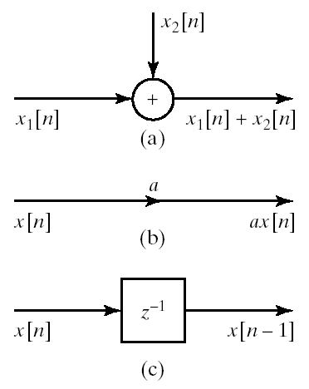
Block Diagram Representation
LTI systems can be represented as constant-coefficient difference equation
The implementation of difference equations requires delayed values of the
  input
  output
  intermediate results
The requirement of delayed elements implies need for storage
We also need means of
  addition
  multiplication

Slide 3
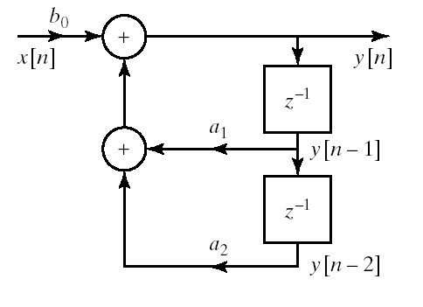
Example
Block diagram representation of

Slide 4
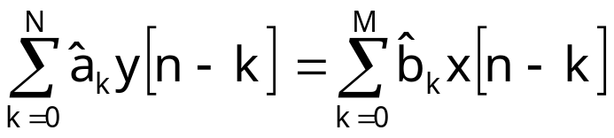
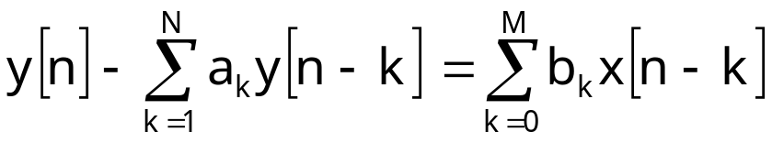
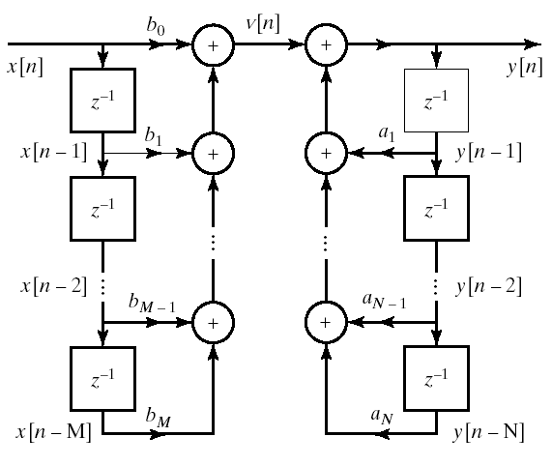
Direct Form I
General form of difference equation
Alternative equivalent form

Slide 5
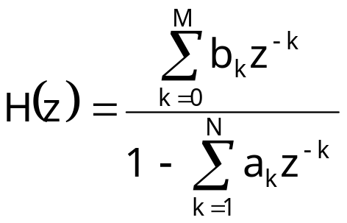
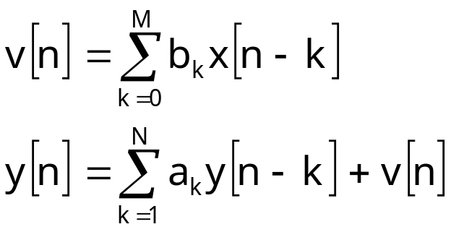
Direct Form I
Transfer function can be written as
Direct Form I Represents

Slide 6
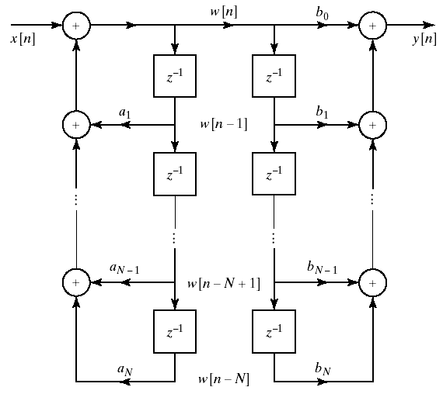
Alternative Block Diagram
We can change the order of the cascade systems

Slide 7
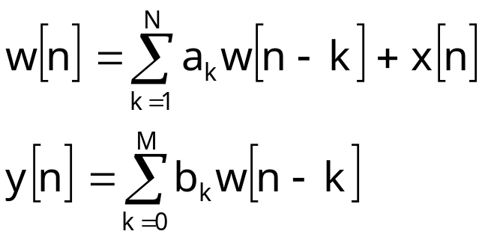
Alternative Block Diagram
We can change the order of the cascade systems

Slide 8
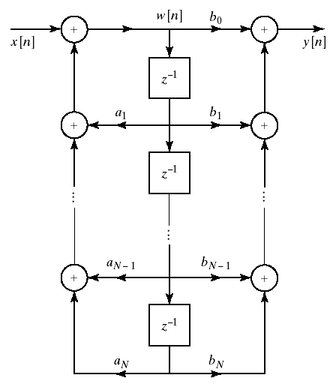
Direct Form II
No need to store the same data twice in previous system
So we can collapse the delay elements into one chain
This is called Direct Form II or the Canonical Form
Theoretically no difference between Direct Form I and II
Implementation wise
  Less memory in Direct II

Slide 9
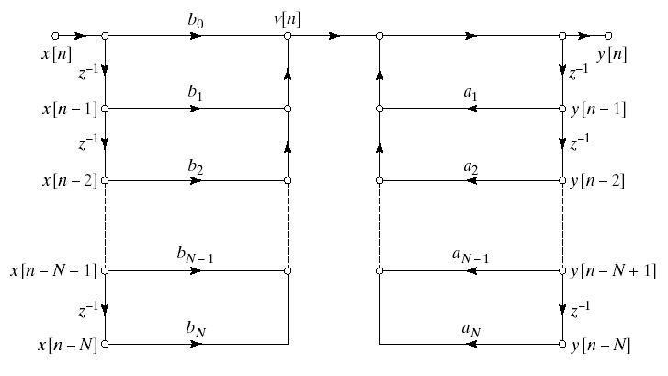
Signal Flow Graph Representation
Direct Form-1

Slide 10
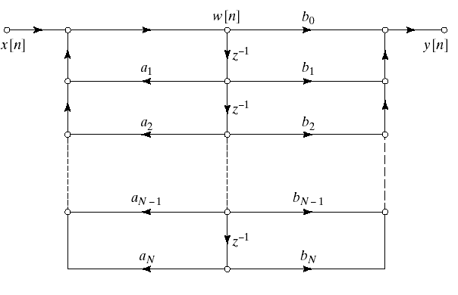
Signal Flow Graph Representation
Direct Form-2

Slide 11
Examples

Slide 12
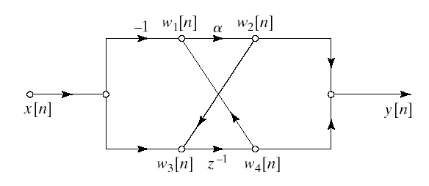
Determination of System Function from Flow Graph

Slide 13
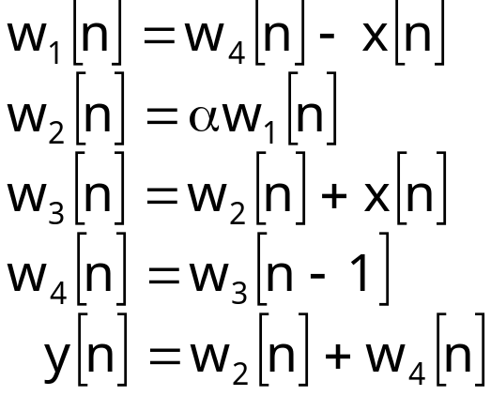
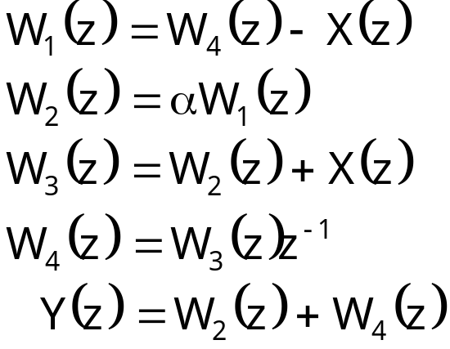
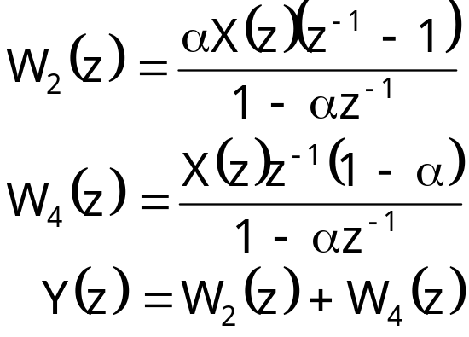
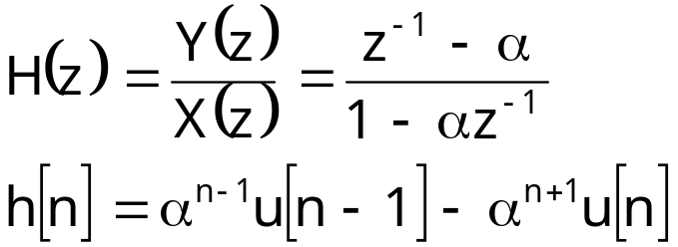
Determination of System Function from Flow Graph

